Slide 1
Overview of Formats

Slide 3
DIGITAL ASSET SPECS
IMAGERY
Formats
.JPG, .PNG, .GIF, .PSD
Vector source files
.SVG, .EPS, .PDF, .AI
We always recommend asking clients for a layered PSD of the ad mockup for quick changes and adjustments.
Font files
.TTF, .OTF
VIDEO
Formats
.MP4, .MOV, .OGG, .FLV, .AVI, .OGV .WEBM, YouTube URL, Vimeo URL, VAST URL.
Resolution
While you can use any width/height in your ads, we recommend an aspect ratio of 16:9 for optimal video quality.
Size
Up to 4MB
(charge occurs after 3MB.)
Duration
Varies, but we recommend 30 seconds or less.
AUDIO
Formats
.MP3 or .MP4.
Notes
Audio players must be user-initiated (default state is muted.)
A custom audio player icon can be uploaded if a transparent .PNG is provided.
LOGOS
Formats
.PNG, .SVG, .EPS
Transparent background preferred.

Slide 4
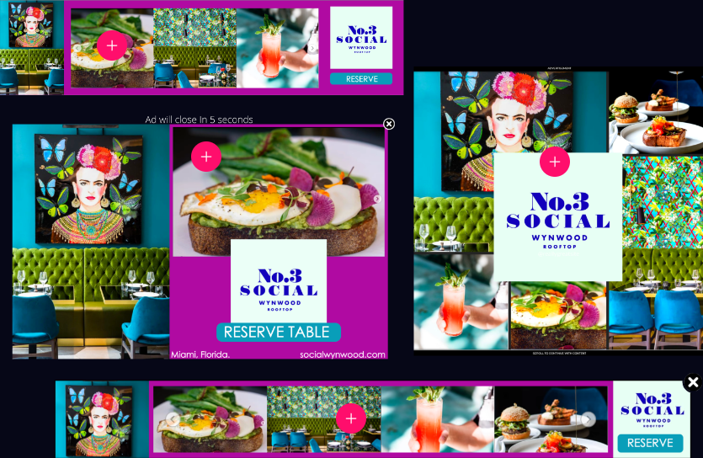
FORMATS
High-impact formats +
cross-screen compatibility.

Slide 5
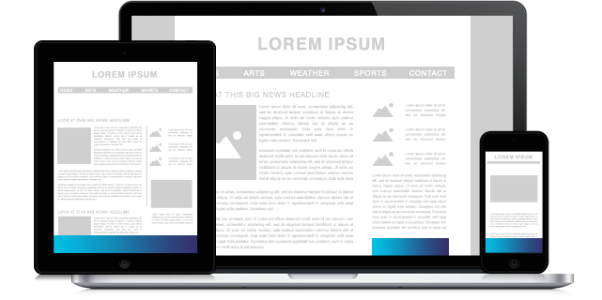
ADHESION
Adhesion ads are always visible and anchored at the bottom or top edge of the screen. They’re also responsive, dynamically resizing for device browser size and orientation, and can expand on click, hover, timed, or in view into a second screen.
Example: Landscaping Adhesion
Learn how to build your own Adhesion unit here.

Slide 6
ADHESION SPECS
Initial Dimensions
Expanded Dimensions
Expand Initiation
Expand Direction
Expand/Close Initiation
Video Format
Max Video File Size
Video Initiation
Suggested Video Length
Mobile Ready
3rd Party Tracking
Creative Assets
Size Varies. Examples: Mobile - 320 x 50, Tablet - 728x90, Desktop - 1024x90
Optional, varies by device. Example: 320x480
On Click, On Hover, On Scroll, Timed, In View, Mobile Swipe, Mobile Shake
Up or Down, depending on position on page
On Click, On Hover, On Scroll, Timed, In View, Mobile Swipe, Mobile Shake
.MP4, .MOV, .OGG, .FLV, .AVI, .OGV .WEBM, YouTube URL, Vimeo URL, VAST URL.
4MB
Auto or User Initiated
30 seconds
Yes
Impression pixel tags, Click tracking tags, Viewability tags
Transparent PNGs for layers, and a PNG or JPG file sized to banner dimensions for background of both initial screen and subsequent expanded state (optional) - Example: 970x90 > 970x415

Slide 7
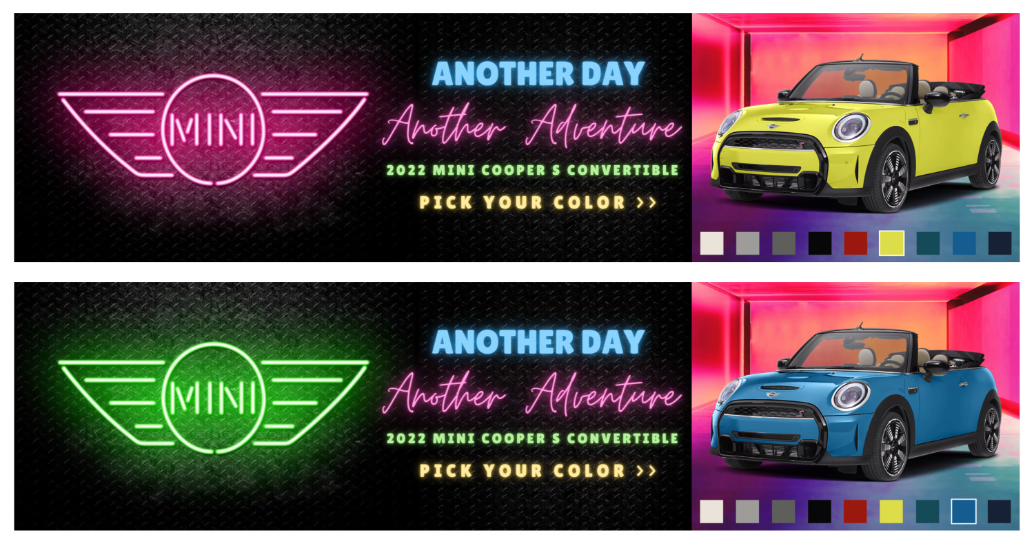
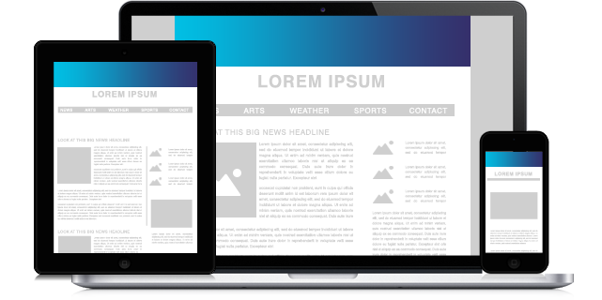
BANNER
The Banner ad format is a standard non-expanding ad unit. Though standard, a banner is a great base to start with when adding rich media components to your ad, such as videos and animations.
Note - you can add additional screens to your banner ad by clicking the + icon in the screens and layers panel.
Example: Banner with Video
Learn how to build your own Banner unit here.

Slide 8
BANNER SPECS
Initial Dimensions
Video Format
Max Video File Size
Video Initiation
Suggested Video Length
Mobile Ready
3rd Party Tracking
Creative Assets
Size varies depending on site
.MP4, .MOV, .OGG, .FLV, .AVI, .OGV .WEBM, YouTube URL, Vimeo URL, VAST URL.
4MB
Auto or User Initiated
30 seconds
Yes
Impression pixel tags, Click tracking tags, Viewability tags
Transparent PNGs for layers, and a PNG or JPG file sized to banner dimensions for background

Slide 9
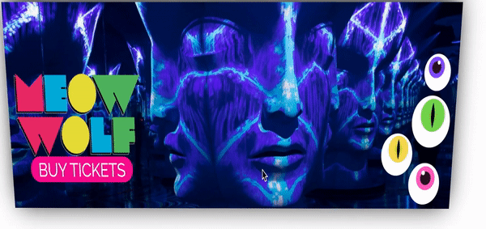
3D BANNER
Create a captivating Banner ad with stunning touch-friendly 3D parallax hover effects! Add multiple transparent layers to allow elements to ”pop out” of the ad.
Note - you can add additional screens to your banner ad by clicking the + icon in the screens and layers panel.
Example: 3D Banner with Video
Learn how to build your own 3D Banner unit here.

Slide 10
3D BANNER SPECS
Initial Dimensions
Video Format
Max Video File Size
Video Initiation
Suggested Video Length
Mobile Ready
3rd Party Tracking
Creative Assets
Size varies depending on site
.MP4, .MOV, .OGG, .FLV, .AVI, .OGV .WEBM, YouTube URL, Vimeo URL, VAST URL.
4MB
Auto or User Initiated
30 seconds
Yes
Impression pixel tags, Click tracking tags, Viewability tags
Transparent PNGs for layers, and a PNG or JPG file sized to banner dimensions for background

Slide 11
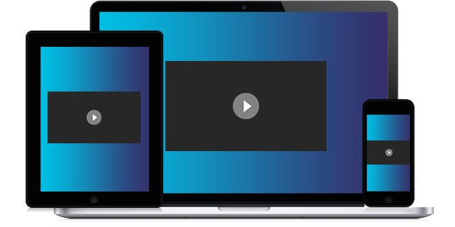
CINEMA
The Cinema ad format is a high-impact format that looks great on any screen. It launches as a responsive, full–width expanded bleeding edge unit with a safe area in the middle of the ad.
The Cinema format fills the screen providing a ton of rich media real estate to grab brand awareness. Users are able to then scroll down to reveal page content or close the ad unit altogether.
Example: Adidas Cinema
Learn how to build your own Cinema unit here.

Slide 12
CINEMA SPECS
Background Dimensions
Video Format
Max Video File Size
Video Initiation
Suggested Video Length
Mobile Ready
3rd Party Tracking
Creative Assets
Size varies depending on site, try 1800px or 2400px to start
.MP4, .MOV, .OGG, .FLV, .AVI, .OGV .WEBM, YouTube URL, Vimeo URL, VAST URL.
4MB
Auto or User Initiated
30 seconds
Yes
Impression pixel tags, Click tracking tags, Viewability tags
Video file (if using), transparent PNGs for layers, and a PNG or JPG file sized to ad unit dimensions for background

Slide 13
CUBE
The Cube ad format is a dynamic rotating ad, which displays multiple screens of imagery in an interactive cube. Our Cube format is eye-catching, engaging and can be used to drive brand awareness and engagement, as they show off their best images in a way that commands attention. Cube can automatically rotate, and also rotate on user swipe.
Example: Summer Fashion Cube
Learn how to build your own Cube format here.

Slide 14
CUBE SPECS
Initial Dimensions
Video Format
Max Video File Size
Video Initiation
Suggested Video Length
Mobile Ready
3rd Party Tracking
Creative Assets
Size varies depending on site
.MP4, .MOV, .OGG, .FLV, .AVI, .OGV .WEBM, YouTube URL, Vimeo URL, VAST URL.
4MB
Auto or User Initiated
30 seconds
Yes
Impression pixel tags, Click tracking tags, Viewability tags
Transparent PNGs for layers, and four background PNG or JPG image layers sized to unit dimensions for each side of cube

Slide 15
ECLIPSE
The Eclipse ad format is an immersive, dynamic experience that opens to a full screen video or background image while ensuring visual awareness of the main sites navigation. Can utilize uploaded video, or a YouTube video URL.
Example: Visit Finland Eclipse
Learn how to build your own Eclipse format here.

Slide 16
ECLIPSE SPECS
Background Dimensions
Video Format
Max Video File Size
Video Initiation
Suggested Video Length
Mobile Ready
3rd Party Tracking
Creative Assets
Screen 1 - Responsive video/image wall
Screen 2 - (Optional leave behind screen) dimensions vary depending on site
.MP4, .MOV, .OGG, .FLV, .AVI, .OGV .WEBM, YouTube URL, Vimeo URL, VAST URL.
4MB
Auto or User Initiated
30 seconds
Yes
Impression pixel tags, Click tracking tags, Viewability tags
Screen 1 - Video file and transparent PNGs for layers to be placed over the video screen
Screen 2 - Transparent PNGs for layers, and a PNG or JPG file sized to dimensions for background

Slide 17
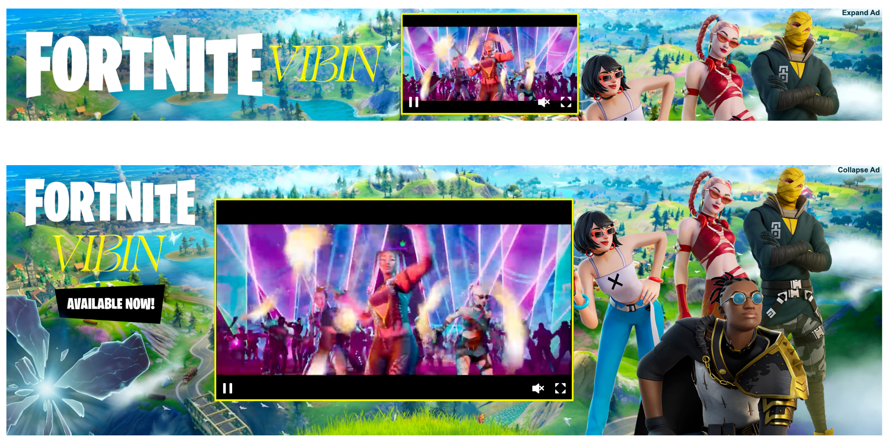
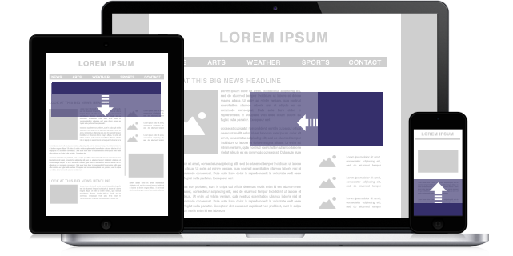
EXPANDABLE
The Expandable format can be served into any ad placement and can expand in any direction of your choice. Unit will expand over page content.
Initially, expandable ads are created with 2 screens - Screen 1 (collapsed state) and Screen 2 (expanded state).
Expandable ads are great for saving on initial ad real estate and are effective at communicating messages to your audience.
Example: Monkey Gin Animated Expandable
Learn how to build your own here.

Slide 18
EXPANDABLE SPECS
Initial Dimensions
Expanded Dimensions
Expand Initiation
Expand Direction
Expand/Close Initiation
Video Format
Max Video File Size
Video Initiation
Suggested Video Length
Mobile Ready
3rd Party Tracking
Creative Assets
Size Varies
Varies by site and device
On Click, On Hover, On Scroll, Timed, In View, Mobile Swipe, Mobile Shake
Up, Down, Left, Right
On Click, On Hover, On Scroll, Timed, In View, Mobile Swipe, Mobile Shake
.MP4, .MOV, .OGG, .FLV, .AVI, .OGV .WEBM, YouTube URL, Vimeo URL, VAST URL.
4MB
Auto or User Initiated
30 seconds
Yes
Impression pixel tags, Click tracking tags, Viewability tags
Transparent PNGs for layers, and a PNG or JPG file for background layers, sized to ad unit dimensions for initial screen and subsequent expanded state
- Example: 970x90, 970x250

Slide 19
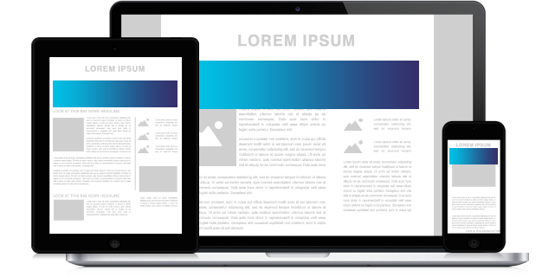
FLEXIBLE AD
The Flexible ad format is a responsive, non-expanding ad unit that will adapt to all devices and screen resolutions. Flexible ads are based on IABs new standard ad unit portfolio.
The ad can have different sizes within it’s defined size range, but must always maintain its aspect ratio. For example, commonly used ad sizes like the 728x90 would be replaced by a flexible aspect ratio based on ad size such as 6:1 or 4:1.
Example: Starbucks Flex
To learn how to create your own flexible ad unit, click here.

Slide 20
FLEXIBLE SPECS
Initial Dimensions
Video Format
Max Video File Size
Video Initiation
Suggested Video Length
Mobile Ready
3rd Party Tracking
Creative Assets
Size based on ratio rather than pixels (ex. 2x1, 3x5, 4x9)
.MP4, .MOV, .OGG, .FLV, .AVI, .OGV .WEBM, YouTube URL, Vimeo URL, VAST URL.
4MB
Auto or User Initiated
30 seconds
Yes
Impression pixel tags, Click tracking tags, Viewability tags
Transparent PNGs for layers, and a PNG or JPG file sized to unit dimensions for background

Slide 21
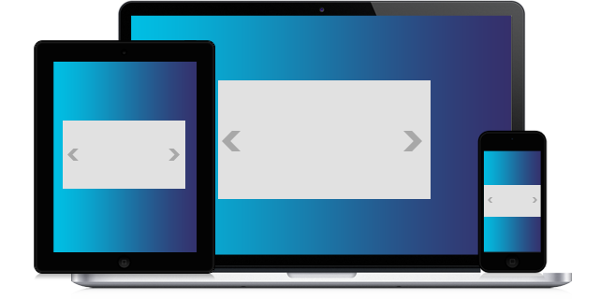
FULL PAGE FLEX
The Full Page Flex ad format is fully responsive and auto sizes depending on the device/screen orientation. It covers 100% of the screen.
You can add multiple components to a flex format to enrich the complexity of the unit.
Example: Full page flex with slideshow
Build your own here.

Slide 22
FULL PAGE FLEX SPECS
Initial Dimensions
Video Format
Max Video File Size
Video Initiation
Suggested Video Length
Mobile Ready
3rd Party Tracking
Creative Assets
Full screen background image, size varies. Example widths: 1800px, 2400px, 2600px, etc
.MP4, .MOV, .OGG, .FLV, .AVI, .OGV .WEBM, YouTube URL, Vimeo URL, VAST URL.
4MB
Auto or User Initiated
30 seconds
Yes
Impression pixel tags, Click tracking tags, Viewability tags
Transparent PNGs for layers, PNG or JPG file sized to unit dimensions for background, and video file (if using)

Slide 23
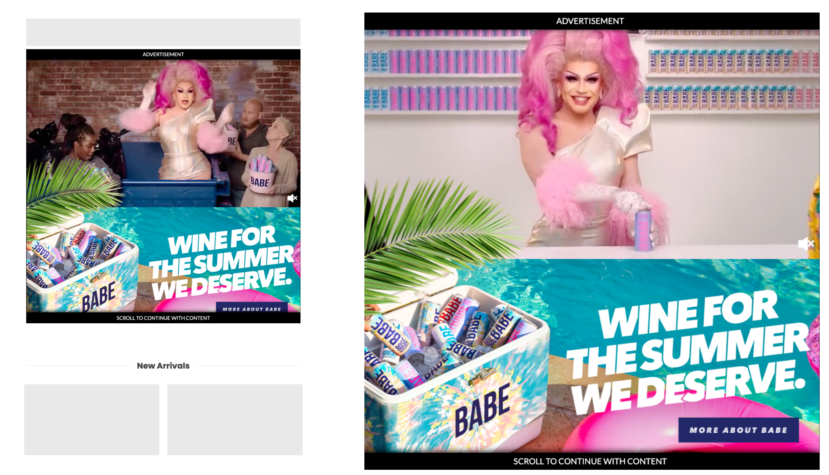
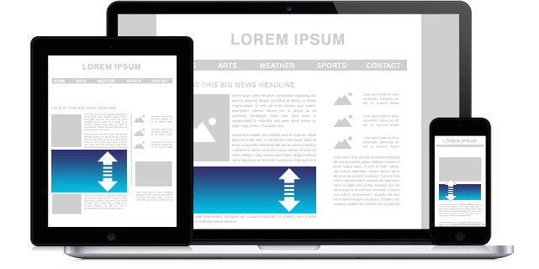
INTERSCROLLER
The Interscroller ad format is a non-intrusive,
in-feed ad unit, scrolling into view as a user scrolls through content (inline, in-feed). This format is automatically responsive, and can include video, slideshows or other rich components.
Example: Babe Video Interscroller
Learn how to build your own scroller reveal unit here.

Slide 24
INTERSCROLLER SPECS
Initial Dimensions
Video Format
Max Video File Size
Video Initiation
Suggested Video Length
Mobile Ready
3rd Party Tracking
Creative Assets
Size Varies. Example: Desktop - 2560x1440, Tablet - 1024x1024, Mobile - 736x736
.MP4, .MOV, .OGG, .FLV, .AVI, .OGV .WEBM, YouTube URL, Vimeo URL, VAST URL.
4MB
Auto or User Initiated
30 seconds
Yes
Impression pixel tags, Click tracking tags, Viewability tags
Transparent PNGs for layers, and a PNG or JPG file sized to unit dimensions for background

Slide 25
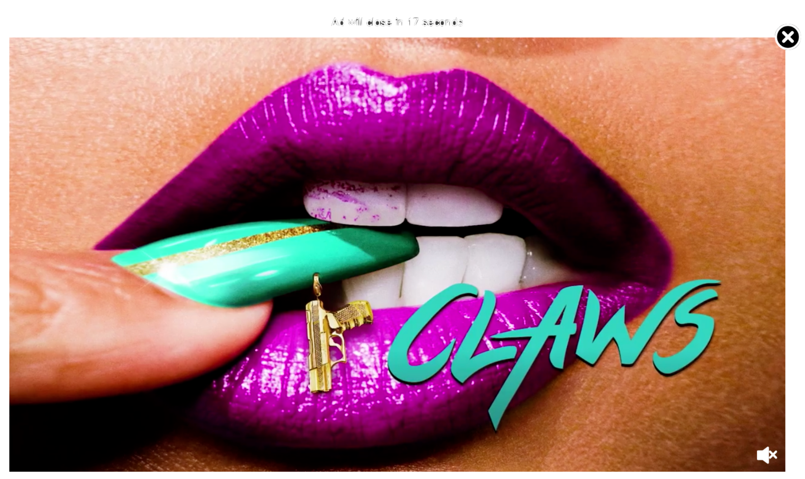
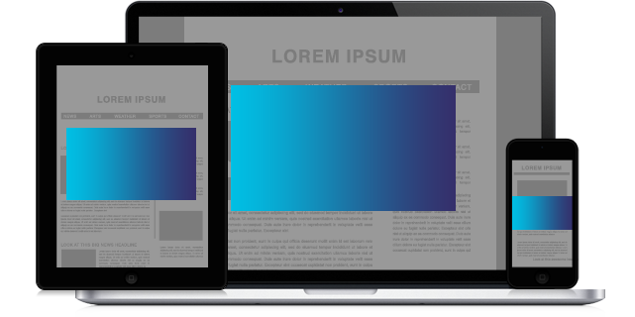
INTERSTITIAL
The Interstitial / Overlay Ad format is a fully responsive, between-the-page (or roadblock) unit that may/may not require user action to proceed and can incorporate rich media.
It can also float and expand over the page content and close into a standard in-page ad on click, hover, or automatically.
Example: Claws Interstitial with Video
Learn how to create your own interstitial here.

Slide 26
INTERSTITIAL SPECS
Initial Dimensions
Video Format
Max Video File Size
Video Initiation
Suggested Video Length
Mobile Ready
3rd Party Tracking
Creative Assets
Size varies by site
.MP4, .MOV, .OGG, .FLV, .AVI, .OGV .WEBM, YouTube URL, Vimeo URL, VAST URL.
4MB
Auto or User Initiated
30 seconds
Yes
Impression pixel tags, Click tracking tags, Viewability tags
Transparent PNGs for layers, and a PNG or JPG file sized to unit dimensions for background

Slide 27
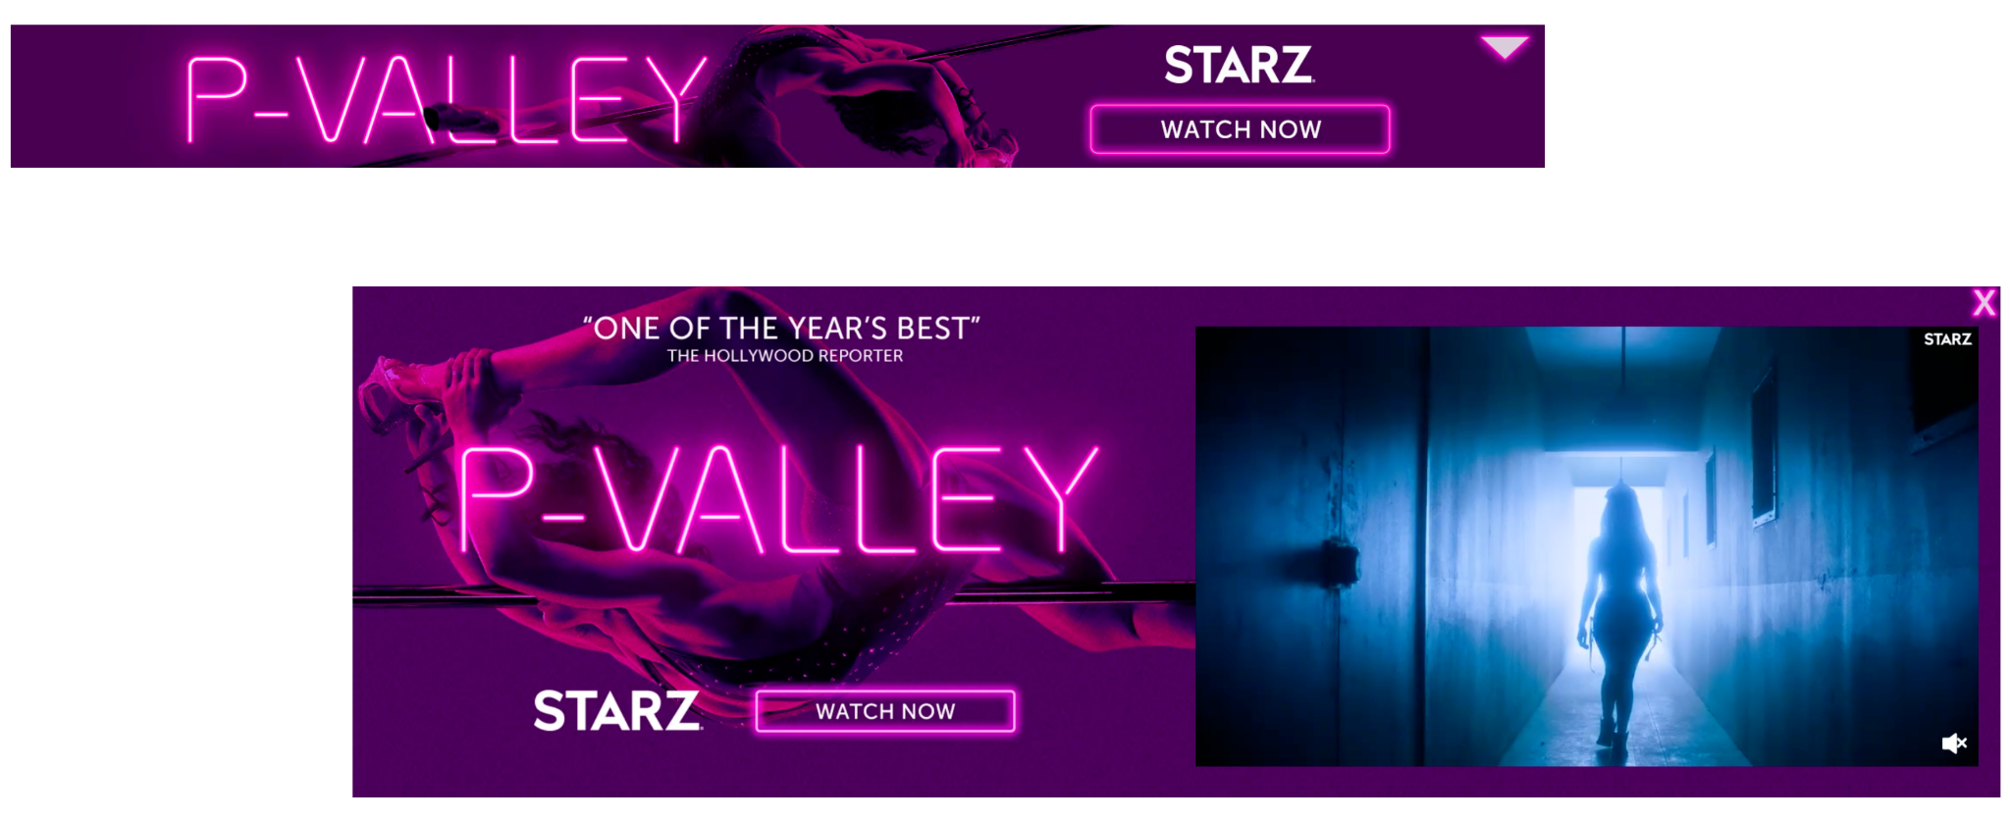
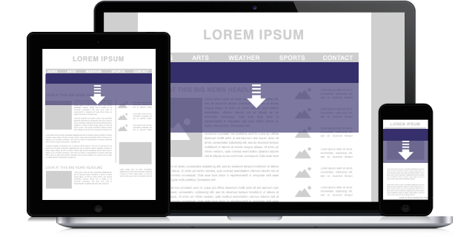
MARQUEE
The Marquee Ad format is great for showcasing rich content and is positioned at the top of the page, underneath a site’s global navigation, or nested in page content.
Our Marquee format is designed to truncate based on the width of the screen it is viewed on.
Example: Marquee Banner w/ Video
Learn more about this format here.

Slide 28
MARQUEE SPECS
Initial Dimensions
Expanded Dimensions
Expand Initiation
Expand Direction
Expand/Close Initiation
Video Format
Max Video File Size
Video Initiation
Suggested Video Length
Mobile Ready
3rd Party Tracking
Creative Assets
Size Varies
Varies by site and device
On Click, On Hover, On Scroll, Timed, In View, Mobile Swipe, Mobile Shake
Up, Down, Left, Right
On Click, On Hover, On Scroll, Timed, In View, Mobile Swipe, Mobile Shake
.MP4, .MOV, .OGG, .FLV, .AVI, .OGV .WEBM, YouTube URL, Vimeo URL, VAST URL.
4MB
Auto or User Initiated
30 seconds
Yes
Impression pixel tags, Click tracking tags, Viewability tags
Transparent PNGs for layers, and a PNG or JPG file sized to dimensions for initial screen and subsequent expanded state - Example: 970x90, 970x415

Slide 29
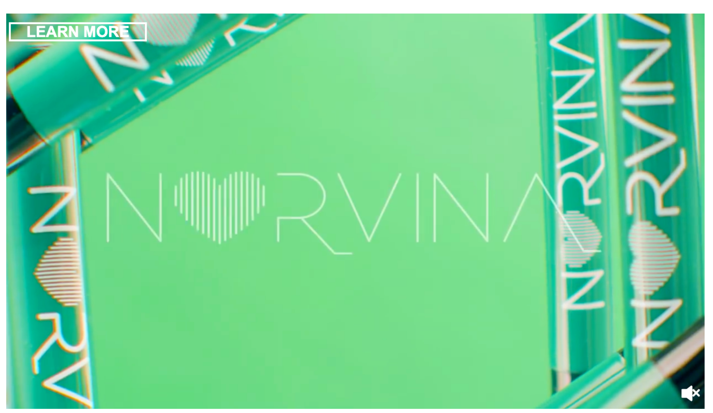
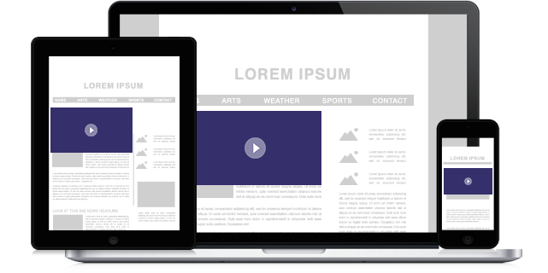
OUTSTREAM VIDEO
Outstream ads are in-feed video ads often placed between articles, paragraphs of text or images on a site.
Outstream ads have some of the highest viewability rates as they can be placed anywhere on site and are triggered only when in view. These ads load beautifully across desktop, tablet and mobile – including Android and iOS.
Example: Old Navy Outstream Video
Learn how to build your own unit here.

Slide 30
OUTSTREAM VIDEO SPECS
Initial Dimensions
Video Format
Max Video File Size
Video Initiation
Suggested Video Length
Mobile Ready
3rd Party Tracking
Creative Assets
Size varies depending on site
.MP4, .MOV, .OGG, .FLV, .AVI, .OGV .WEBM, YouTube URL, Vimeo URL, VAST URL.
4MB
Auto or User Initiated
30 seconds
Yes
Impression pixel tags, Click tracking tags, Viewability tags
Video

Slide 31
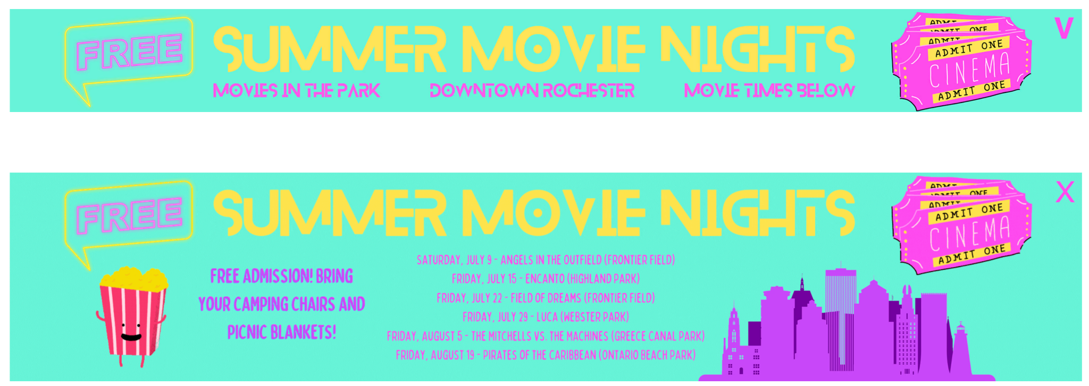
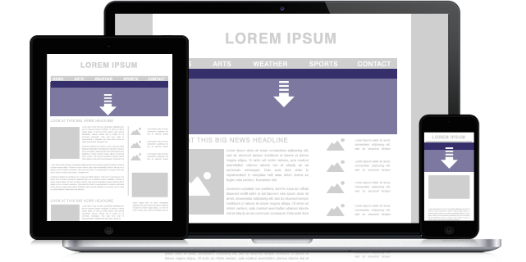
PUSHDOWN
The Pushdown Ad format will load as a teaser and on click, hover, timed or in view, it pushes down the page content to reveal a large ad (per site specs).
Example: Summer Movie Nights Pushdown
Learn how to build your own scroller reveal unit here.

Slide 32
PUSHDOWN SPECS
Initial Dimensions
Expanded Dimensions
Expand Initiation
Expand Direction
Expand/Close Initiation
Video Format
Max Video File Size
Video Initiation
Suggested Video Length
Mobile Ready
3rd Party Tracking
Creative Assets
Size Varies
Varies by Site and Device
On Click, On Hover, On Scroll, Timed, In View, Mobile Swipe, Mobile Shake
Up, Down, Left, Right
On Click, On Hover, On Scroll, Timed, In View, Mobile Swipe, Mobile Shake
.MP4, .MOV, .OGG, .FLV, .AVI, .OGV .WEBM, YouTube URL, Vimeo URL, VAST URL.
4MB
Auto or User Initiated
30 Seconds
Yes
Impression pixel tags, Click tracking tags, Viewability tags
Transparent PNGs for layers, and a PNG or JPG file sized to dimensions for initial screen and subsequent expanded state - Example: 970x90, 970x415

Slide 33
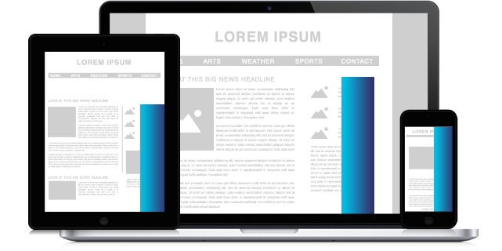
STICKY SIDEBAR
The Sticky Sidebar ad format slides into view on the left or right side of the page and will follow the user as they scroll. This is an effective way to get eyes on your creative. Can support multiple screens for expandable functionality.
Example: Summer Reading Expanding Sticky Sidebar
Learn how to build your own here.

Slide 34
STICKY SIDEBAR SPECS
Initial Dimensions
Expanded Dimensions
Expand Initiation
Expand direction
Expand/Close Initiation
Video Format
Max Video File Size
Video Initiation
Suggested Video Length
Mobile Ready
3rd Party Tracking
Creative Assets
Size Varies
Varies by site and device
On Click, On Hover, On Scroll, Timed, In View, Mobile Swipe, Mobile Shake
Left or Right
On Click, On Hover, On Scroll, Timed, In View, Mobile Swipe, Mobile Shake
.MP4, .MOV, .OGG, .FLV, .AVI, .OGV .WEBM, YouTube URL, Vimeo URL, VAST URL.
4MB
Auto or User Initiated
30 seconds
Yes
Impression pixel tags, Click tracking tags, Viewability tags
Transparent PNGs for layers, and a PNG or JPG file sized to dimensions of initial screen and subsequent expanded state - Example: 970x90, 970x415

Slide 35
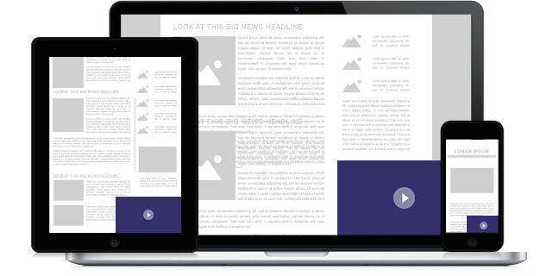
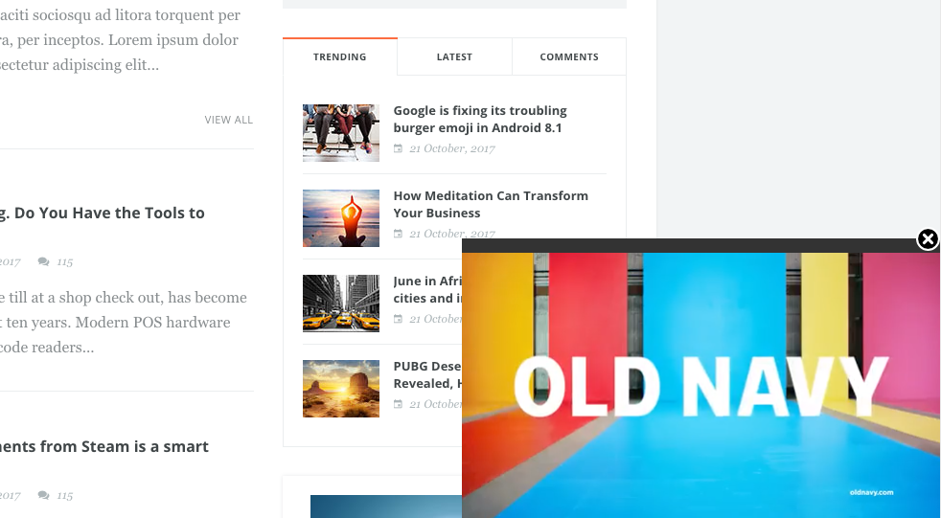
STICKY VIDEO
Any video ad units that integrate custom hosted video can be made sticky. Sticky video functionality is a great way to boost view-through rates.
When a user scrolls past a video ad made sticky, and the unit moves out of the viewable area of the screen, the video automatically pops out and anchors to a specified location on screen.
The video loads between articles initially. Just scroll past the in-feed video and you'll see the video pop up in the lower right-hand corner of the screen.
Example: ABC Outstream w/ Sticky Video
Learn how to build your own here.

Slide 36
STICKY VIDEO SPECS
Initial Dimensions
Video Format
Max Video File Size
Video Initiation
Suggested Video Length
Mobile Ready
3rd Party Tracking
Creative Assets
Size Varies
.MP4, .MOV, .OGG, .FLV, .AVI, .OGV .WEBM, YouTube URL, Vimeo URL, VAST URL.
4MB
Auto or User Initiated
30 seconds
Yes
Impression pixel tags, Click tracking tags, Viewability tags
Video file and images for additional content - PNG or JPG file for initial screen and subsequent expanded state - Example: 970x90, 970x415

Slide 37
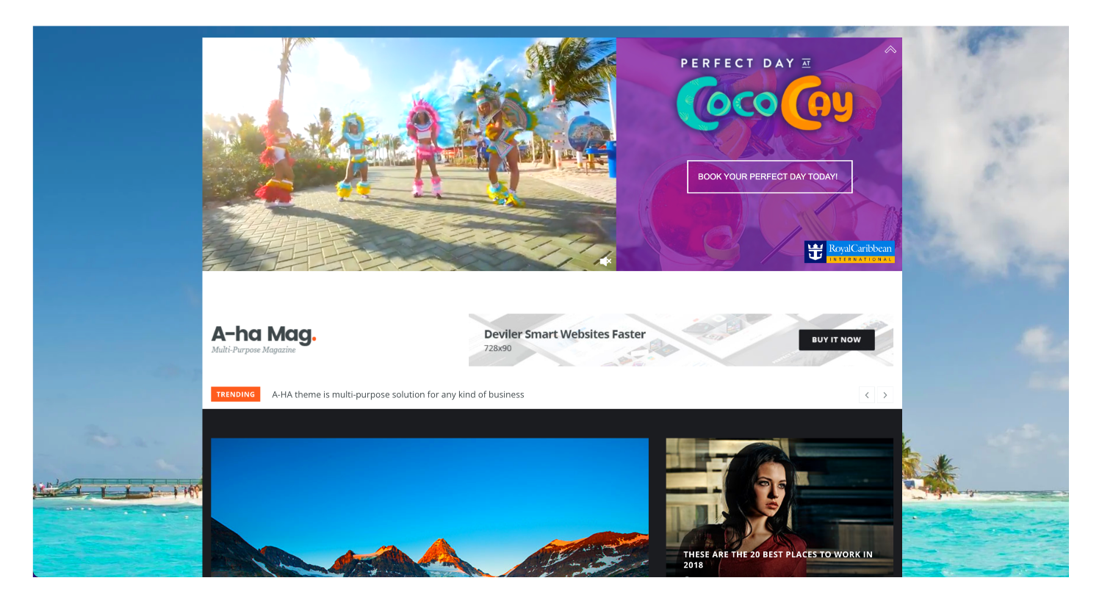
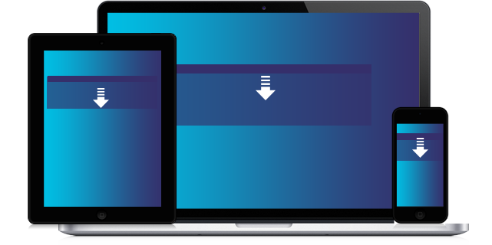
TAKEOVER
The Takeover format will load as a teaser billboard in the foreground, with a Wallpaper (two floating gutters on each side of the center content area) in the background. On click, hover, or timed the billboard pushes down the page content to reveal a larger ad (per site specs). Billboard can also be built static (non-expanding).
The Wallpaper portion of this format can include either two sidebar images, or a video/image wall.
These are available exclusively on desktop.
Example: Donuts Takeover w/ Pushdown
Example: Sprint Non-Pushdown Takeover
To learn how to build your own here.

Slide 38
TAKEOVER SPECS
Billboard Dimensions
Pushdown Dimensions
Wallpaper/Floating Image Dimensions
Video Format
Max Video File Size
Video Initiation
Suggested Video Length
Mobile Ready
3rd Party Tracking
Creative Assets
Size varies depending on site
Varies by Site and Device
Size Varies
.MP4, .MOV, .OGG, .FLV, .AVI, .OGV .WEBM, YouTube URL, Vimeo URL, VAST URL.
4MB
Auto or User Initiated
30 seconds
No
Impression pixel tags, Click tracking tags, Viewability tags
Screen 1 - (Billboard) Transparent PNGs for layers, and a PNG or JPG file sized to
unit dimensions for background
Screen 2 - (Optional Pushdown) Transparent PNGs for layers, and a PNG or JPG file
sized to dimensions for background
Wallpaper - Two sidebar images (sizes vary) or a video/image wall

Slide 39
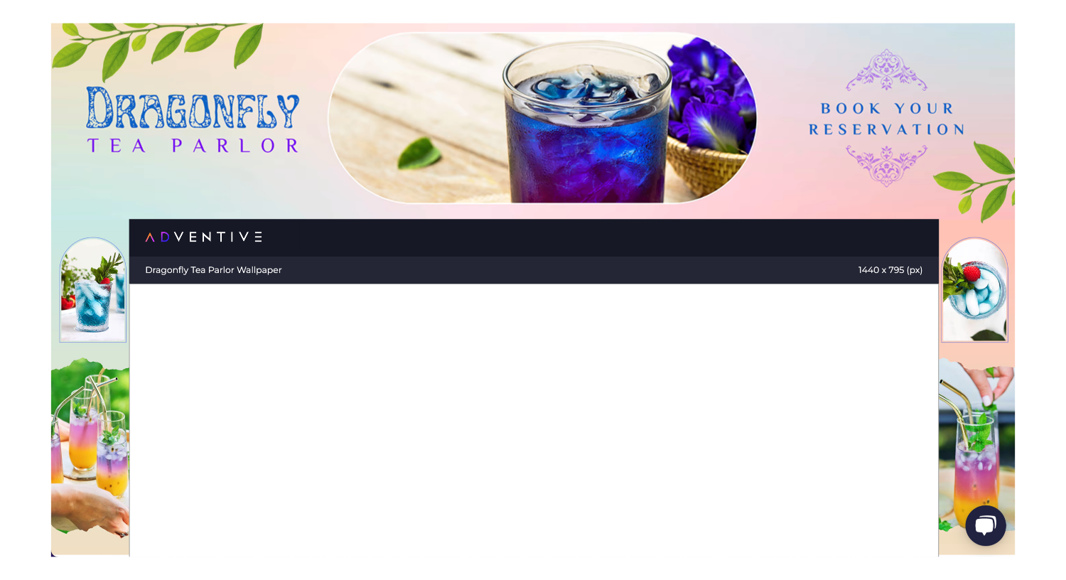
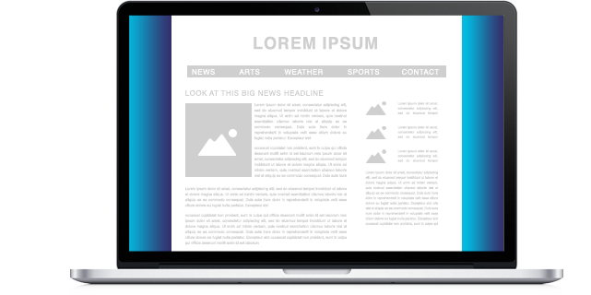
WALLPAPER
The Wallpaper format, or page skin, is a high-impact ad unit that allows you to deliver your brand message in the surrounding space around page content. These are available exclusively on desktop.
Example: Animated FFS Razors Wallpaper
Learn how to build yours here.

Slide 40
WALLPAPER SPECS
Dimensions
Video Format
Max Video File Size
Video Initiation
Suggested Video Length
Mobile Ready
3rd Party Tracking
Creative Assets
Size varies depending on site.
.MP4, .MOV, .OGG, .FLV, .AVI, .OGV .WEBM, YouTube URL, Vimeo URL, VAST URL.
4MB
Auto or User Initiated
30 seconds
No
Impression pixel tags, Click tracking tags, Viewability tags
Transparent PNGs for layers, and PNG or JPG files for background images, sized to dimensions of sidebars and top header areas (if using). Can also use a single background image, to fill header and sidebar areas.

