Slide 1
Overview of Components

Slide 2
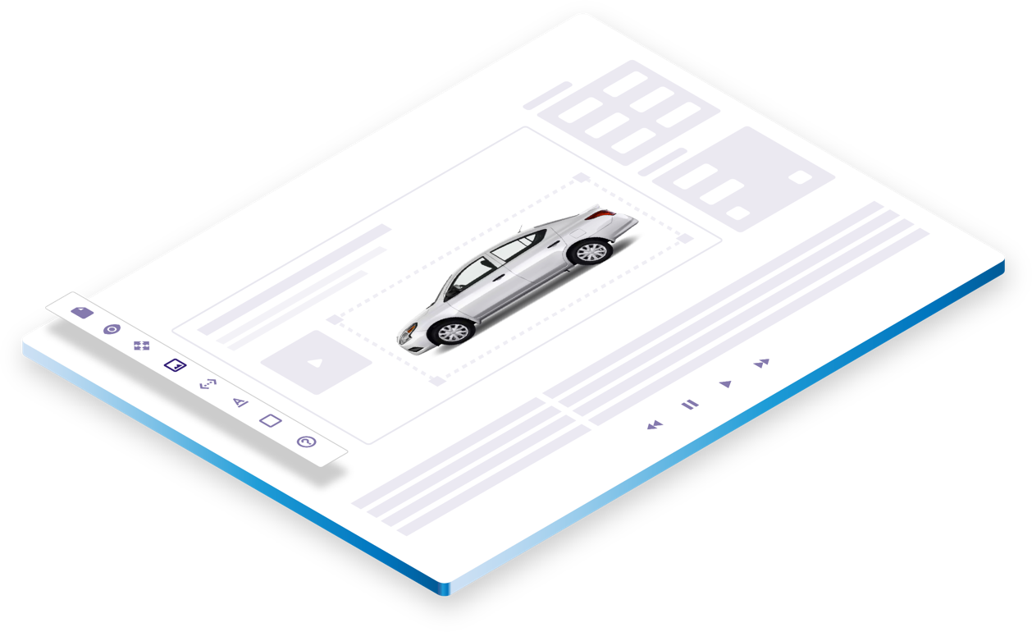
HTML5
AD BUILDER
Drag-and-drop rich media components. No coding required.
Comprehensive rich media production tool with unmatched creative flexibility.
High performance ad formats: expanding, mobile, IAB Rising Stars and custom units.

Slide 3
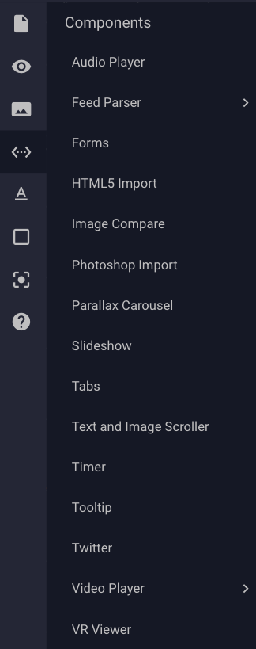
COMPONENTS
Beef up your ad capabilities with our robust library of drag-and-drop rich media components.

Slide 4
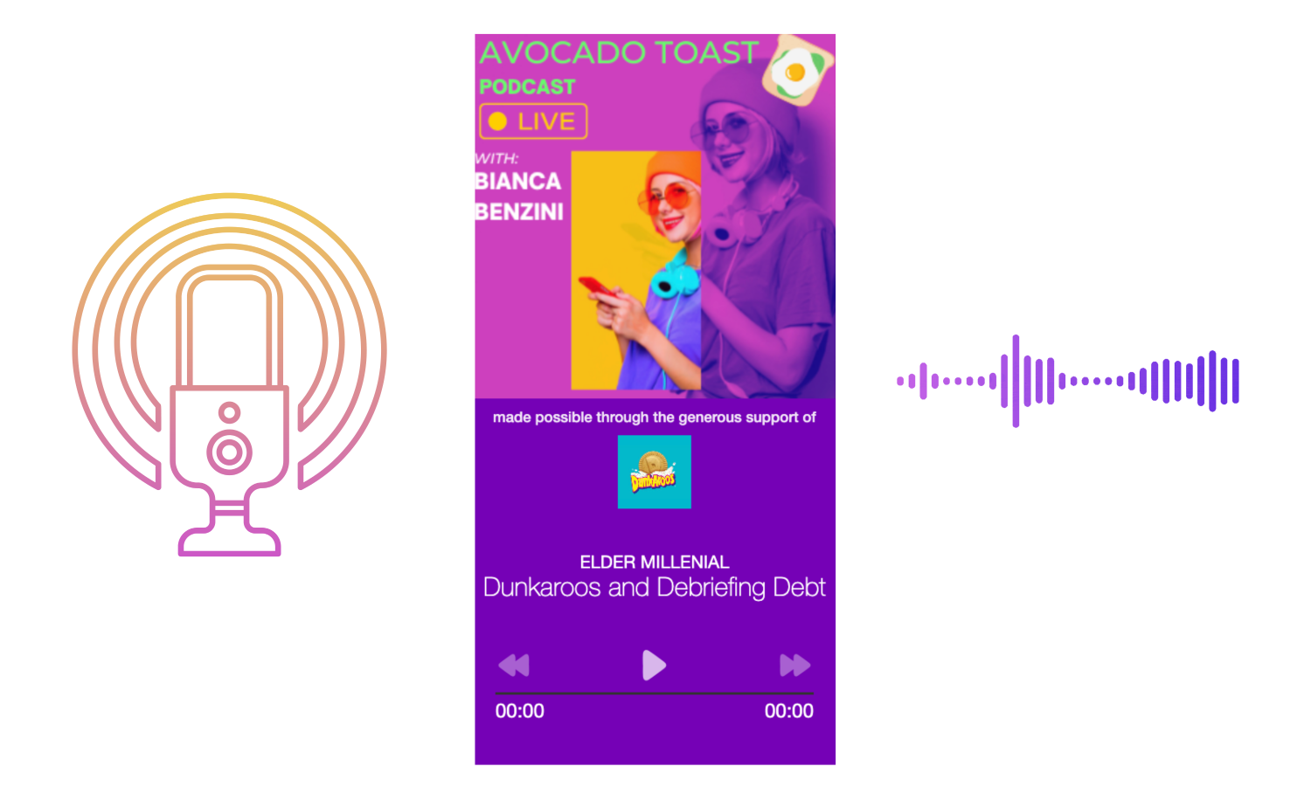
AUDIO PLAYER
Stream music, podcasts, educational and promotional audio to your audience with ease. Integrate multiple podcast links and sponsorship info for easy playback.
Example: Audio Player Sticky Sidebar
Click here to learn how to add this component to your unit.

Slide 5
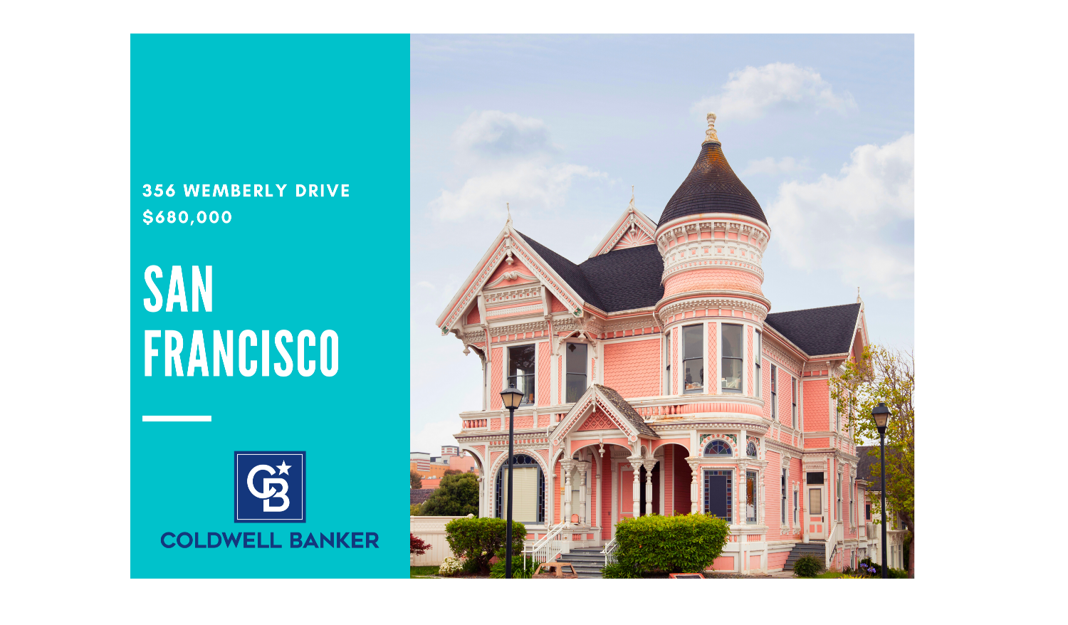
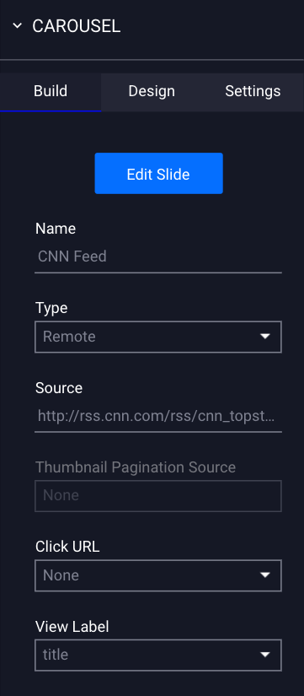
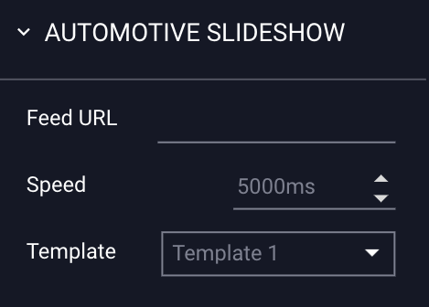
FEED PARSER
(XML & RSS FEED)
The Feed Parser Component allows you to integrate dynamic feeds into your ad unit. Options include XML Carousel, XML Free Form, and Automotive Slideshow:
XML Carousel - Source groups of data points associated with an item.
XML Free Form – Place single data elements within the ad canvas.
Automotive Slideshow - Automotive inventory advertising, specifically for standardized CSV-type feed.
Example: Nasa Breaking News RSS Feed
Example: Automotive Feed
Click here to learn how to add this component to your unit.
For best practices, see this article.

Slide 6
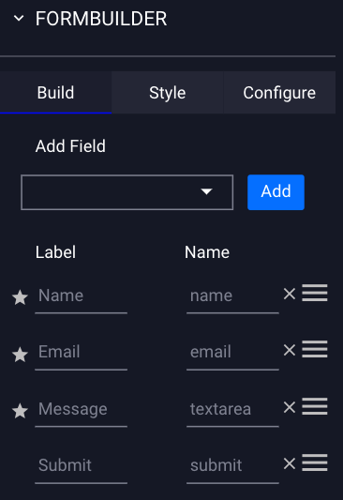
FORMS
The Forms Component allows you to add input fields (such as polls, questionnaires, contest entry forms, etc.) to your ad.
This info can be retrieved from within Adventive, or integrate with your CRM tools.
These are a great way to source valuable information from your viewers.
You can customize your form with build, style, and configuration tools
Example: Cornell Master Gardener Banner
Click here to learn how to add this component to your unit.

Slide 7
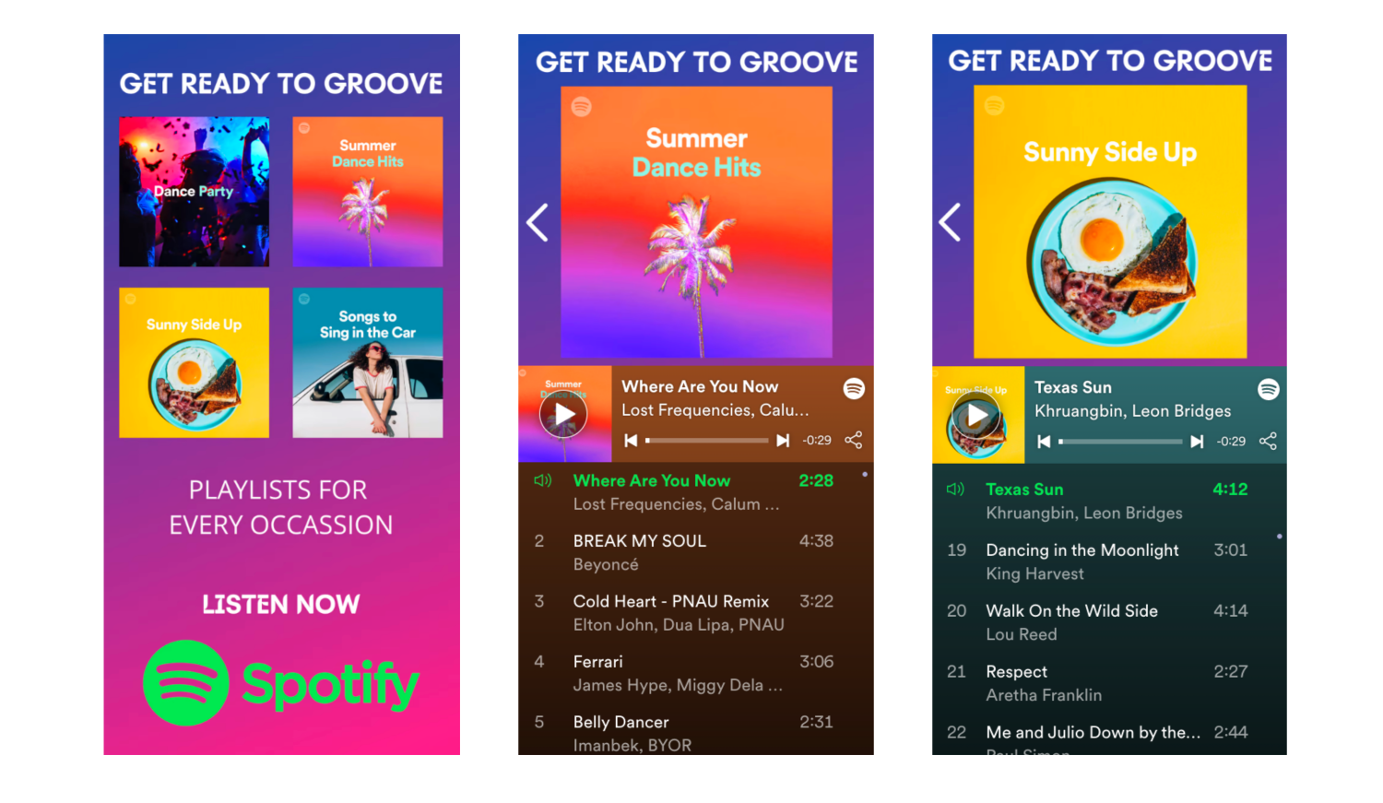
HTML IMPORT
(CODE SNIPPET EDITOR)
Are you looking for an experience we don’t offer natively? The HTML5 Import Component allows you to bring in any Javascript code, upload a ZIP file, or utilize INS tags.
Bring in social feeds, games, quizzes, etc. The sky’s the limit!
This component can be customized to fit your creative needs depending on the ad type.
Example: Spotify Multi-Screen Banner
Click here to learn how to add this component to your unit.

Slide 8
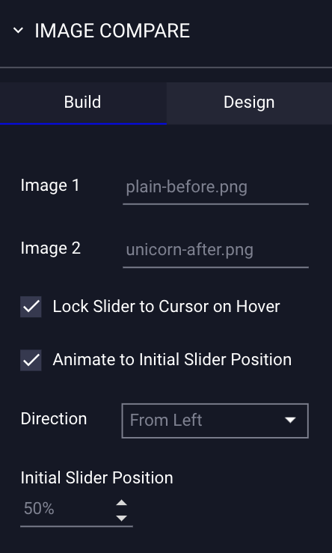
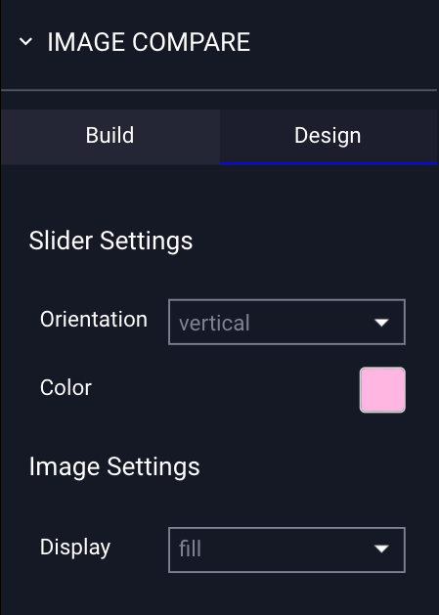
IMAGE COMPARE
Compare before and after imagery with an interaction based slider that your viewer controls.
Example: Donuts Image Compare Banner
Click here to learn how to add this component to your unit.

Slide 9
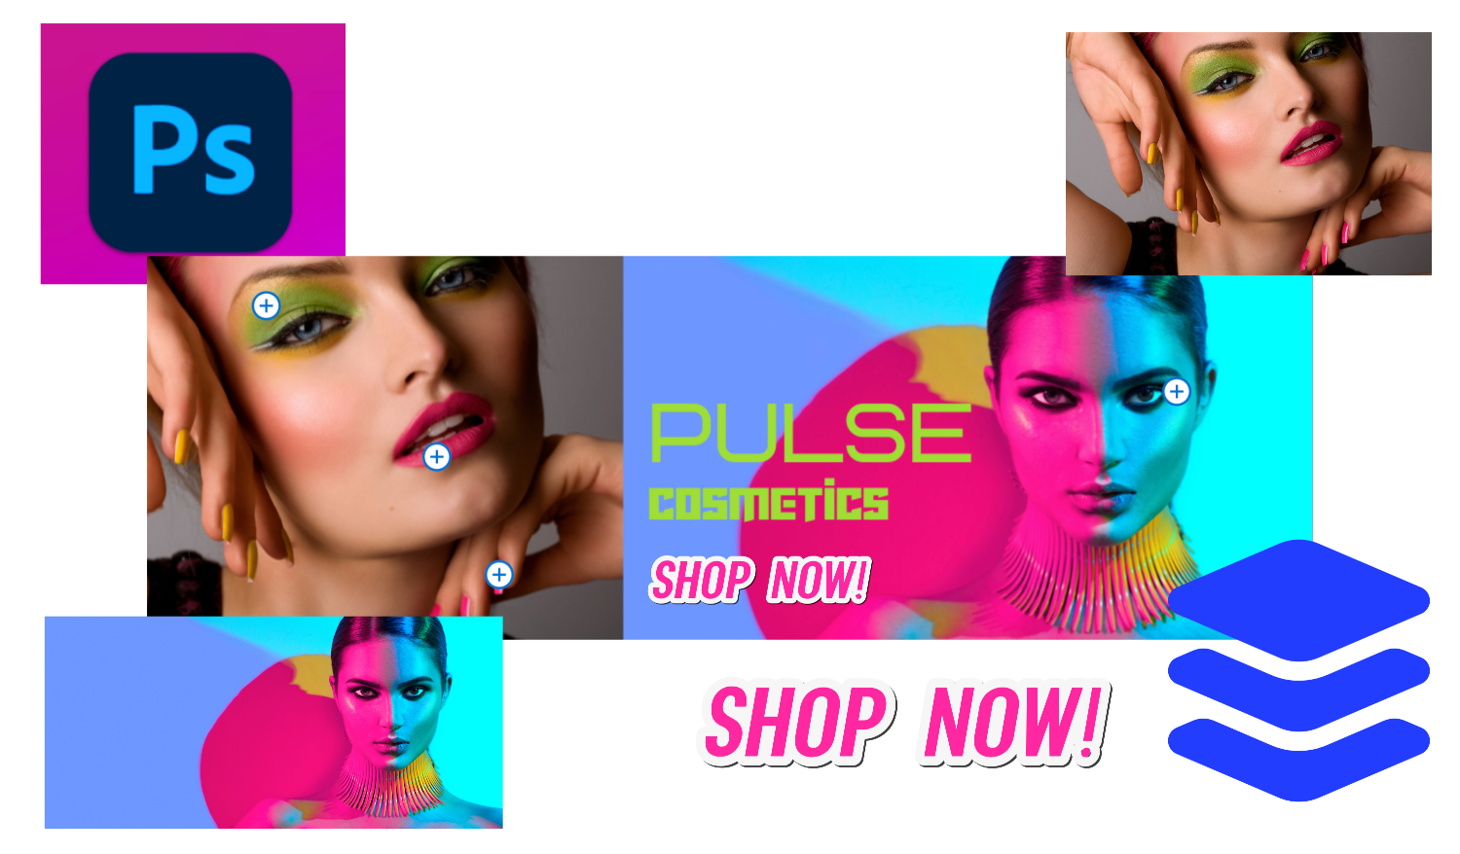
PHOTOSHOP IMPORT
Our Photoshop Import component allows you to upload PSD files directly to your ad canvas.
Our builder will take care of extracting the layers from your file, and import them directly onto your ad canvas as separate, optimized assets, so you don’t have to do the heavy lifting, and so you can isolate layers for animations, actions, and events.
Click Here to learn how to add this component to your ad build.

Slide 10
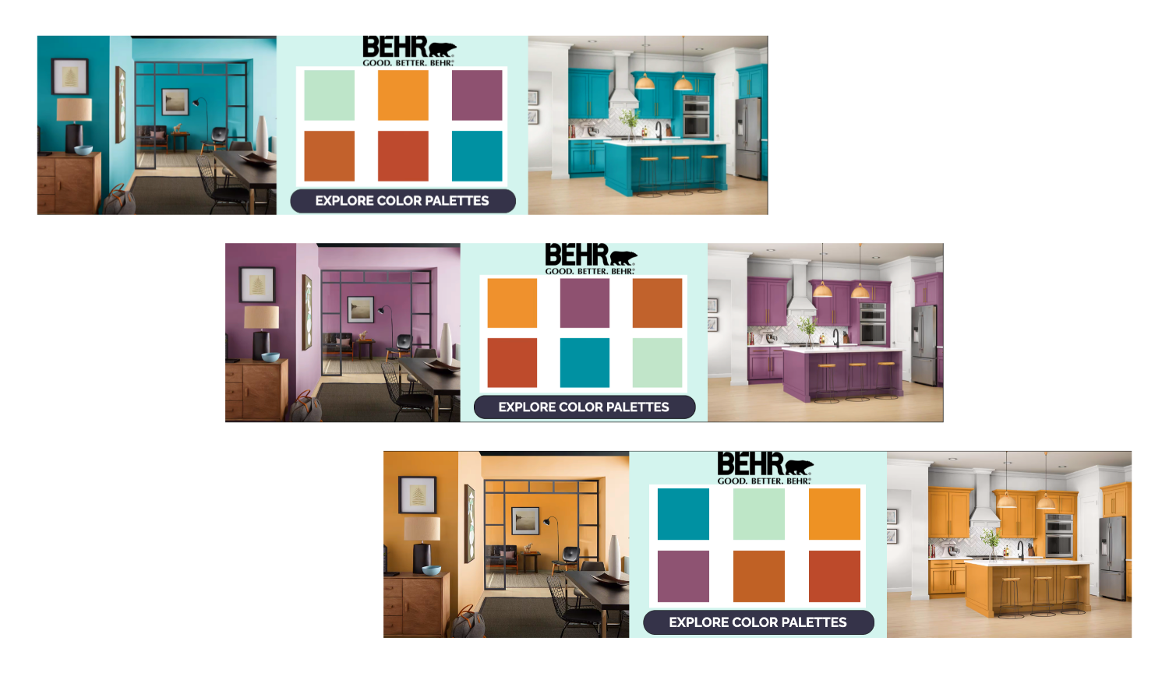
PARALLAX CAROUSEL
The Parallax Carousel Component enables you to upload multiple images (up to 40!) to emulate motion. Whether it’s a 360 degree spin, or simple motion as your scroll, this is a fun and unique way to show off your products and services.
You can enable custom trigger points and speeds to fine tune your advertisement with the click of a button. Furthermore, you can rearrange or replace assets at any given time.
Example: Behr Parallax Carousel
Click here to learn how to integrate this unit into your ads.

Slide 11
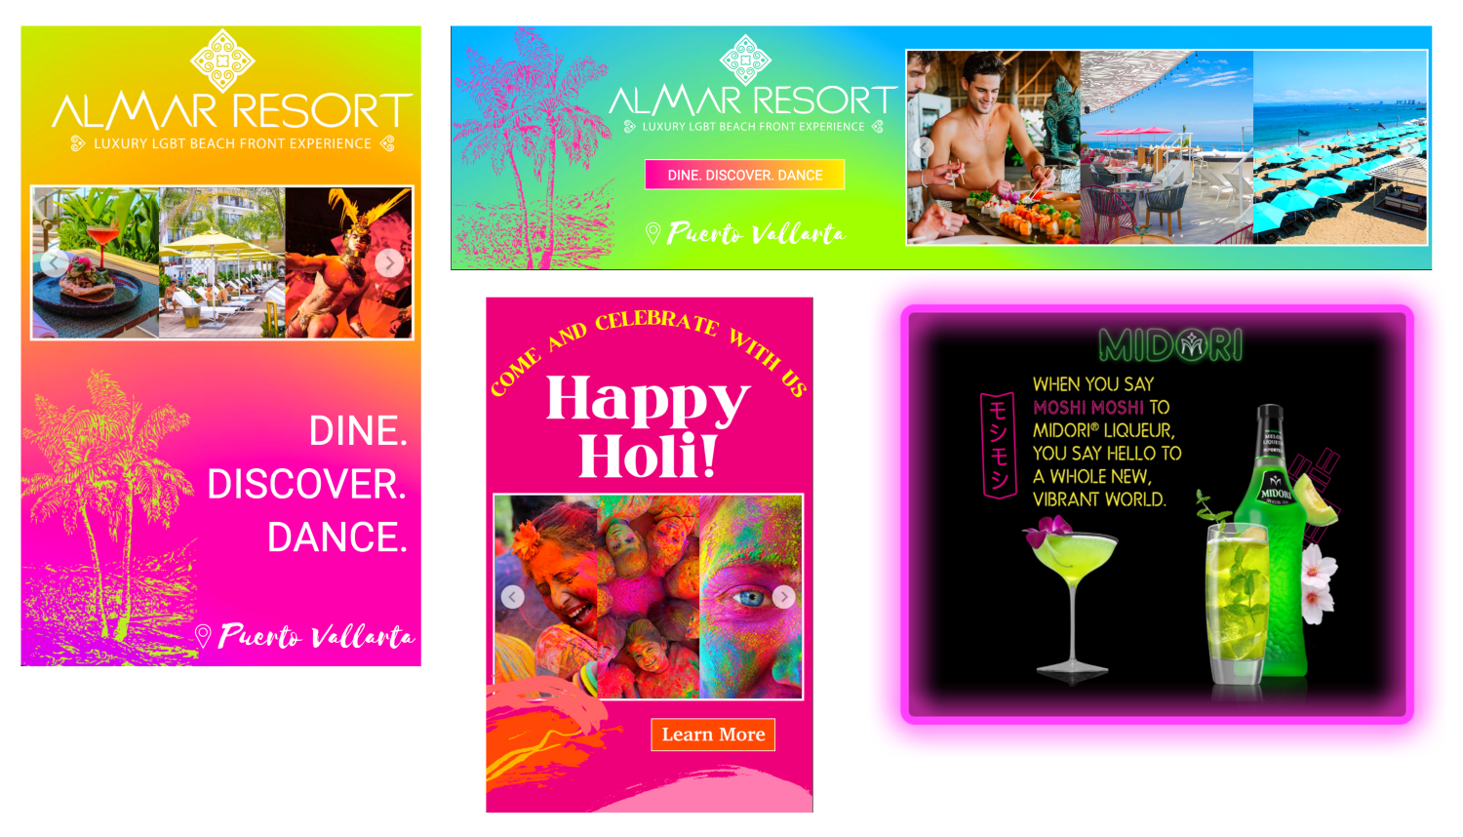
SLIDESHOW
The Slideshow Component allows you to add multiple images/videos to an ad in one location.
This component can be added to any type of Format, and you can add multiple slideshows to one unit.
These units are ideal for shoppable capability, and are an excellent way to showcase multiple items in a confined space.
Example: Jungalow Animated Banner
Click here to learn how to add this component to your unit.

Slide 12
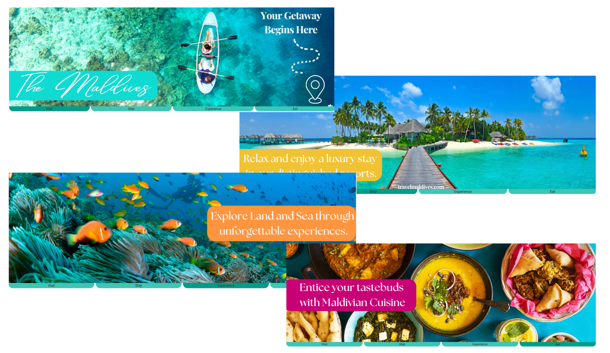
TABS
The Tabs Component allows you to showcase a wealth of content, without sacrificing your ad real estate.
Tabs are ideal for non-expanding or smaller ad formats. You can showcase multiple product creatives within a confined format, maximizing viewability.
Example: Gordon Ramsay Full-Width Banner
Click here to learn how to add this component to your unit.

Slide 13
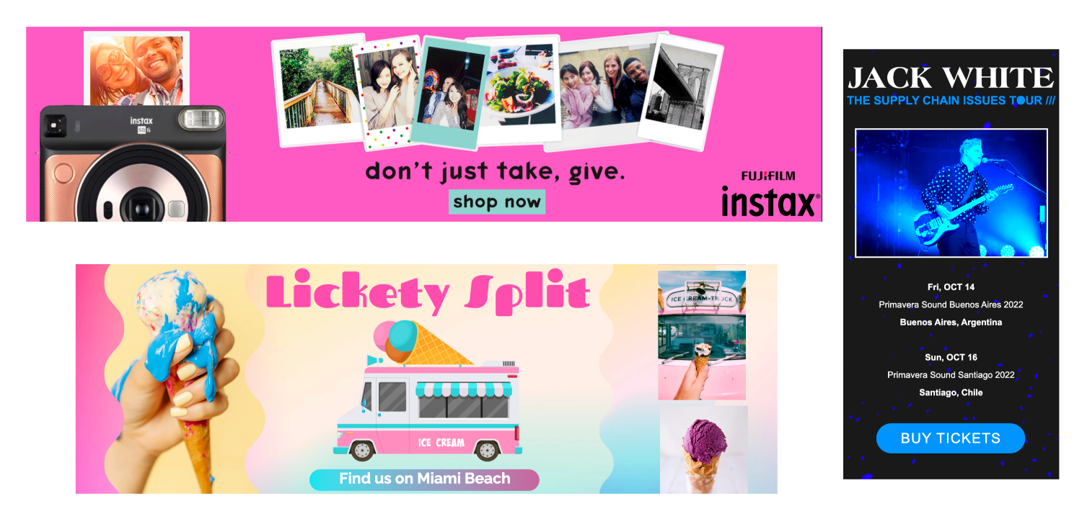
TEXT AND IMAGE SCROLLER
The Text Scroller Component supports bulk rich text insertion and vertical, shoppable images.
Common use cases include medical/legal/crypto disclaimers (IRI, ISI), shoppable images and event dates.
Example: Harper’s Bazaar Shoppable Banner
Click here to learn how to add this component to your unit.

Slide 14
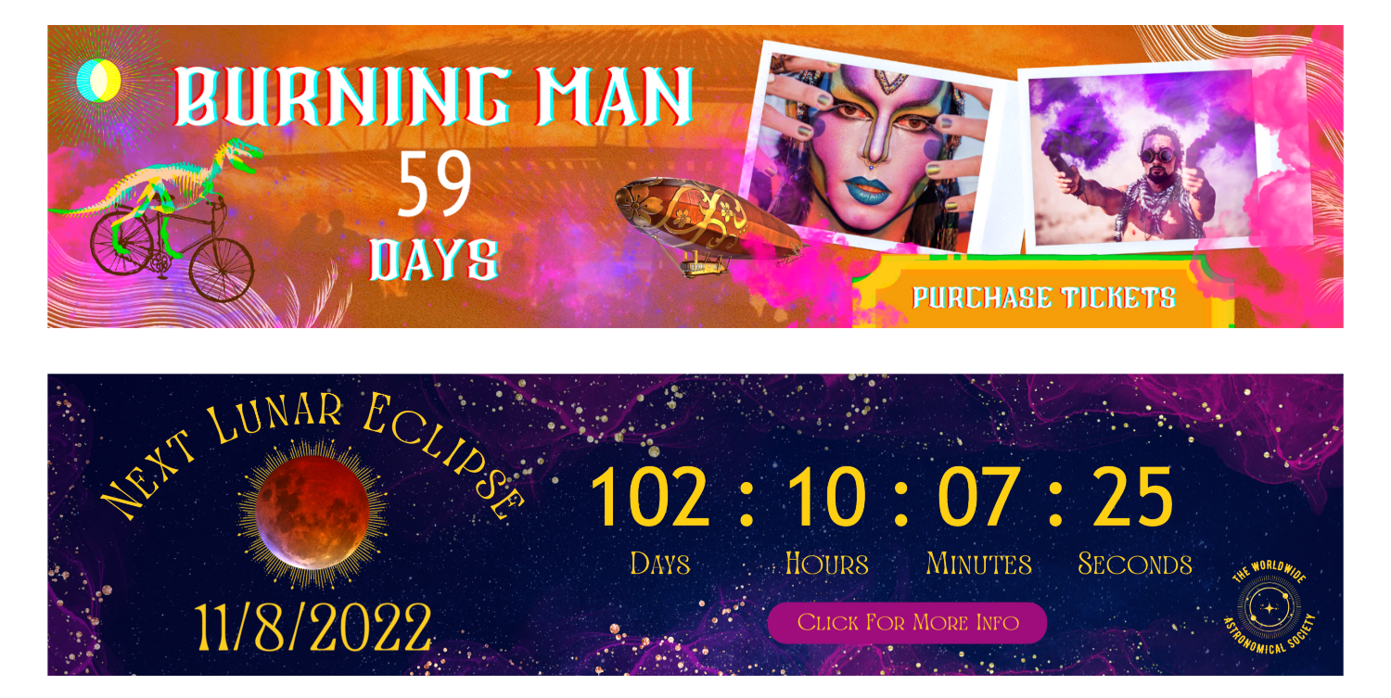
TIMER
The Timer Component allows to build anticipation with a countdown timer. Common use cases include countdowns to sales, events, promotions, and releases.
The Timer can be combined with other components and you can add more than one timer to a single ad unit.
By default, the timer will display the days, hours, minutes, and seconds.
Example: Burning Man Interscroller
Click here to learn how to add this component to your unit.

Slide 15
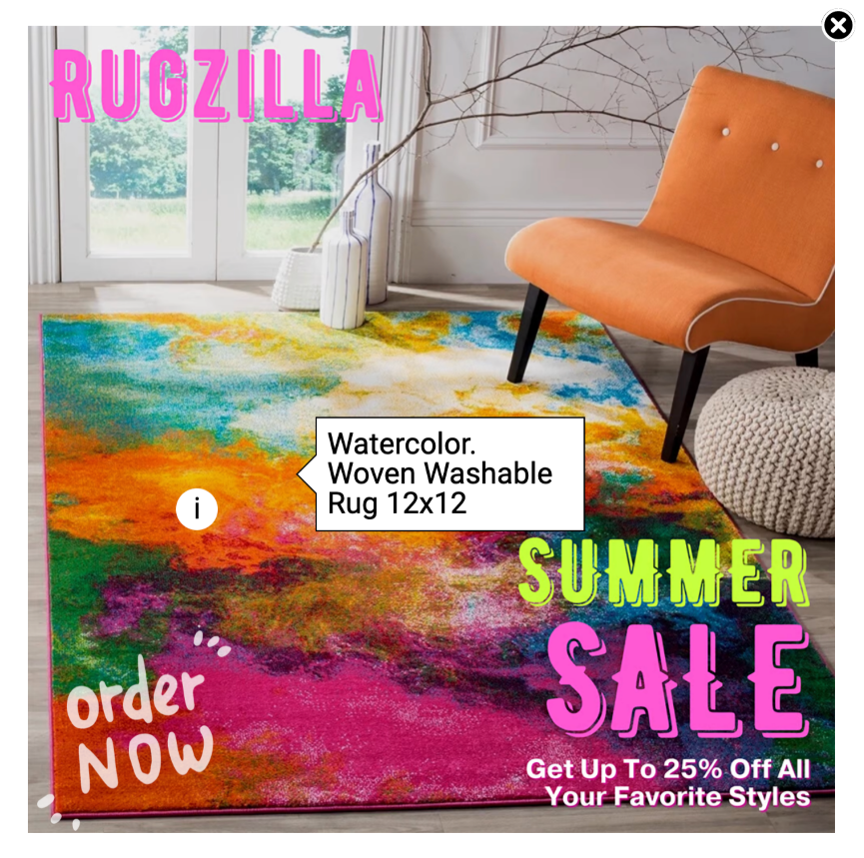
TOOLTIP
The Tool Tip Component is a great way to add extra notes, nuggets of information, or to highlight products or features.
The tool tip visuals are highly customizable- You can edit the size, color, style, and alignment of text. You can also modify the position and direction of the display balloon.
Example: Summer Reading Sticky Sidebar
Click here to learn how to add this component to your unit.

Slide 16
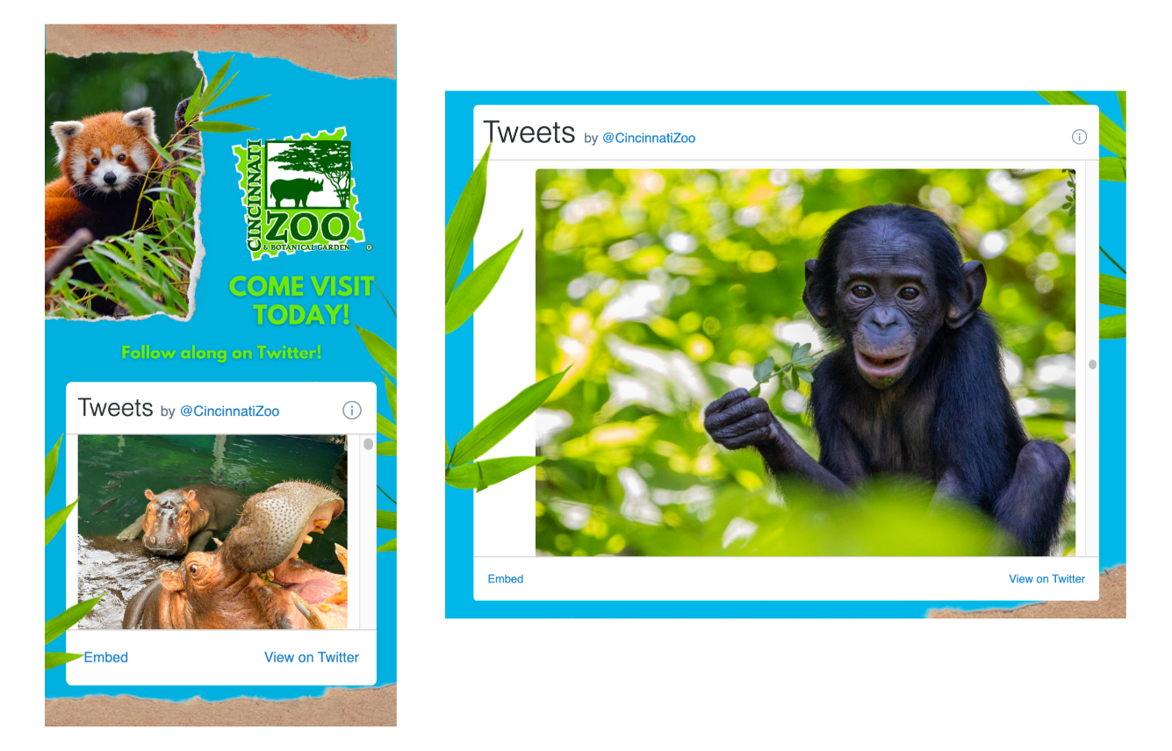
TWITTER INTEGRATION
Adventive provides 5 unique ways to integrate Twitter into your ads with the Twitter Integration Component.
Capabilities include Twitter Share, Mention, Hashtag, Follow, or Timeline to your creative.
Incorporating Twitter functionality is a great way to engage your audience and connect via social media.
Example: Cincinnati Zoo Banner with Twitter Feed
Click here to learn how to add this component to your unit.

Slide 17
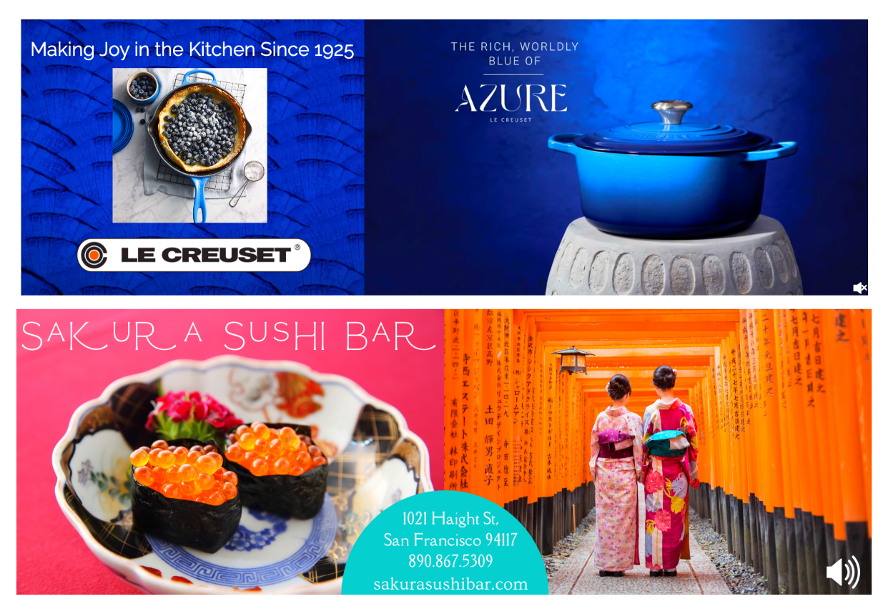
VIDEO
Video is by far the most versatile and engaging way to interact with your viewers through digital advertisements.
Adventive accepts .mp4, .mov, .ogg, .flv, .avi, .ogv, and .webm video file formats for custom hosted video, as well as VAST URL tags, YouTube, and Vimeo video URLs.
Example: Le Creuset In-Banner Video
Click here to learn how to add this component to your unit.
Also see our article Video Asset Optimization.
Our Video Report article will also provide information on quartile reporting and other video metrics.

Slide 18
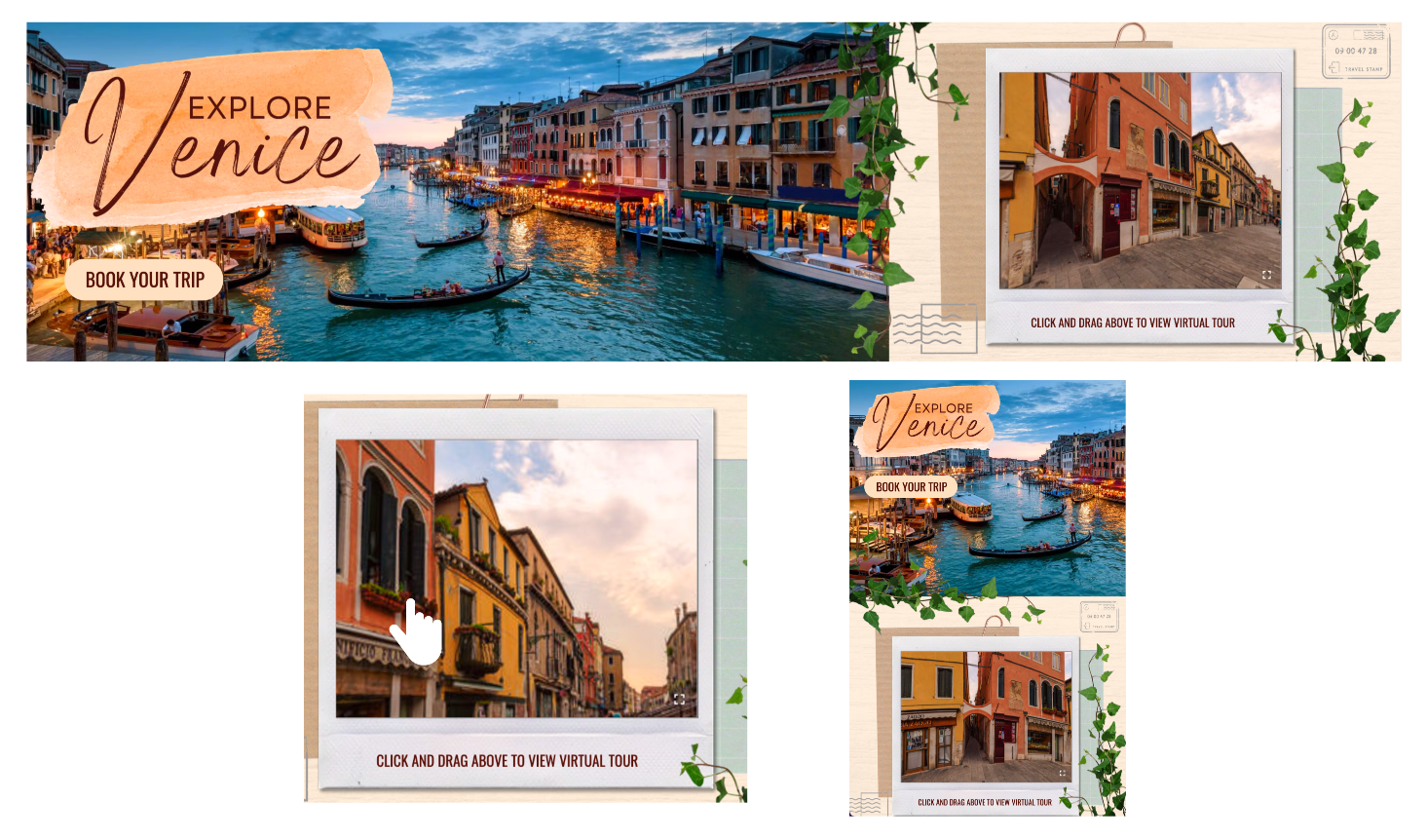
VR VIEWER
(360 VIDEO AND PANORAMIC IMAGES)
Invite your audience to experience ads in a new and interactive way. Our VR Viewer component offers the ability for users to interact with 360 videos and panoramic photos.
This feature works well when showcasing interior views, locations, maps, or anything that is visually-driven.
Example: Venice VR Viewer Banner
Visit these links for more information regarding VR embedding, see here and here.
Click here to learn how to add this component to your unit.

